Slide 1
CLOUD COMPUTING / FINAL PROJECT / MSc DATA SCIENCE
Cloud-Based Healthcare Appointment
System on Microsoft Azure
A secure, multi-tier cloud deployment — managed compute, a private database, passwordless identity, and network isolation.
App Service
Azure SQL
Entra ID
Key Vault
VNet
Private Endpoint
Team: Dimple Vincia Selet Rajendrakumar Roopa · Gayathri Narayanan · Kamalika Bharathi Kannan Umamaheshwari · Maharsh Ashish Shah
University of Europe for Applied Sciences · Prof. Aaron Crandall
Live: https://app-healthappt-gn-axhhfvhbdxerbphw.westeurope-01.azurewebsites.net
Notes:
Good morning — we're team GKDM: Gayathri, Kamalika, Dimple and Maharsh. Our project is a cloud-based healthcare appointment system, built and deployed LIVE on Microsoft Azure. One line: patients sign in with their Microsoft account, book and cancel appointments, and it runs securely on Azure right now.

Slide 2
02
Project Completion Status
The system is built, deployed, and running live on Azure.
✓
PHASE 1
✓
PHASE 2
✓
PHASE 3
✓
PHASE 4
Compute
Database
Security
Deploy + monitor
React + Express on Azure App Service
Private Azure SQL (serverless)
Entra ID login, private endpoint, NSGs
Live deployment + Application Insights
Functional requirements met
Non-functional requirements met
Patients sign in and book, reschedule, or cancel appointments
Providers view their schedule; role-based access (Patient / Provider / Admin)
Live REST API reading and writing a managed cloud database
Secure: Entra ID auth, private database, managed identity, TLS + TDE
Low-cost: serverless database auto-pauses when idle (~$25–40 / month)
Maintainable: documented, repeatable provisioning and deployment
02 / 18
Notes:
The system is fully built, deployed and live. All four phases are done — compute, database, security, and deployment with monitoring. Both our functional goals (booking, roles, a live API) and non-functional goals (secure, low-cost, maintainable) are met.

Slide 3









03
Technology Stack
React + Vite
Node.js + Express
MSAL (msal-react)
Single-page front end
REST API server
Microsoft sign-in
mssql driver
jsonwebtoken + jwks
HTTPS / TLS
Connects to Azure SQL
Validates Entra tokens
Encryption in transit
App Insights SDK
Git
VS Code + Azure
Telemetry & logging
Version control
Build & deploy
03 / 18
Notes:
Front end: React with Vite. Back end: Node + Express as a REST API. Sign-in uses Microsoft's MSAL library; the API talks to Azure SQL with the mssql driver; tokens are validated with jsonwebtoken. Everything is over HTTPS and monitored by Application Insights.

Slide 4






04
Azure Services Used
Azure App Service
Azure SQL Database
Linux Node host serving the React app + Express API
Managed, serverless database in a private subnet
Microsoft Entra ID
Azure Key Vault
User sign-in (OAuth2 / OIDC) and app roles
Secret storage, read via the app's managed identity
Virtual Network + NSGs
Private Endpoint
Private network with subnet firewall rules
Private-only network path to the database
Application Insights
Logs, metrics and request tracing
04 / 18
Notes:
These are the seven Azure services we used. App Service hosts the app; Azure SQL stores the data; Entra ID handles login; Key Vault holds secrets; the VNet and NSGs give us a private, firewalled network; the private endpoint gives a private path to the database; and Application Insights monitors everything. The theme: managed services, so a small team can build something real without managing servers.

Slide 5
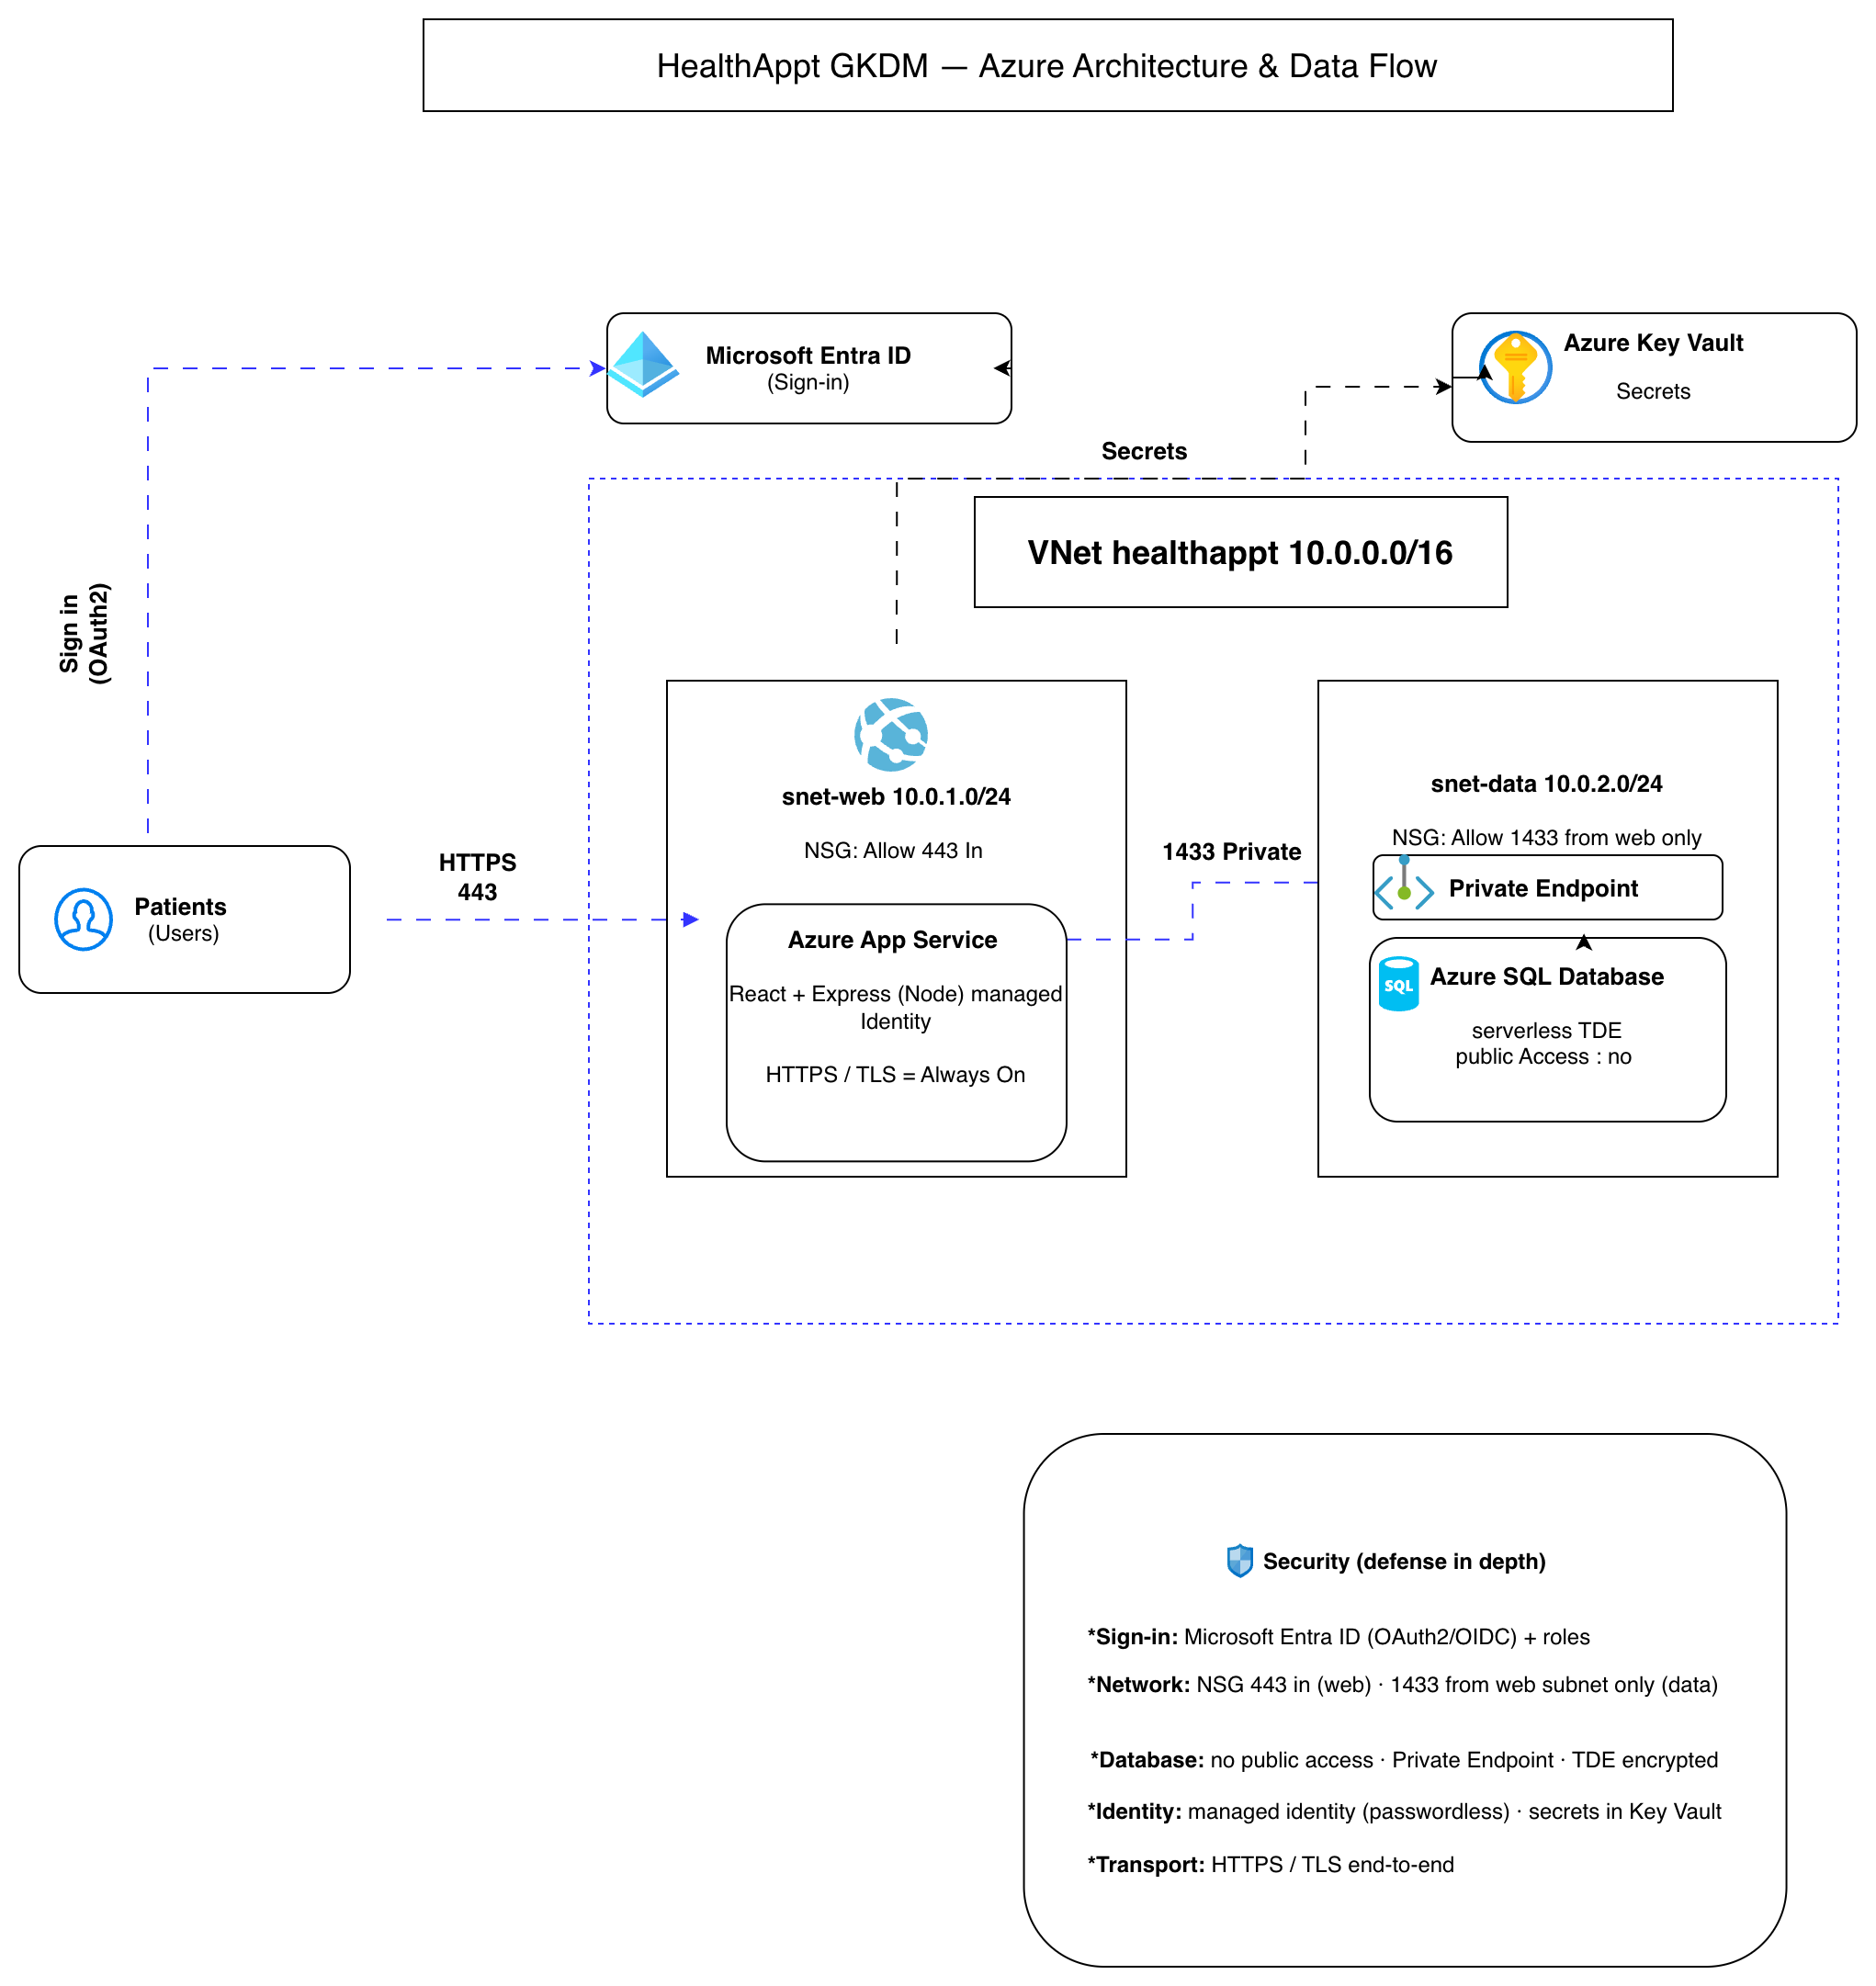
05
Project Solution Architectural Drawing
Hand-drawn, as the course requires — our architecture and secure request flow.
05 / 18
Notes:
Walk the diagram: a patient signs in through Entra ID and gets a token. Their browser calls our App Service over HTTPS on port 443. The App Service reaches the database through a private endpoint on port 1433 — all inside our virtual network, split into a web subnet (10.0.1.0/24) and a data subnet (10.0.2.0/24). The database has NO public access. Secrets come from Key Vault using a managed identity. If asked how the app finds the private database: a private DNS zone resolves the name to its private IP.

Slide 6
06
The Build Process — Start to End
0
Setup
1
Network
2
Database
Resource group, region West Europe, sign in to Azure.
Custom VNet with snet-web / snet-data subnets and NSGs.
Azure SQL serverless; create schema and seed data.
3
Compute
4
Security
5
Deploy
App Service (Node), managed identity, VNet integration.
Private endpoint, disable public DB access, Key Vault, Entra ID app registrations + roles.
Build React → bundle into the API → deploy via VS Code; wire Application Insights.
06 / 18
Notes:
We built it in six steps: set up the resource group and region; build the private network with two subnets and firewall rules; create the serverless SQL database and its tables; deploy the App Service with a managed identity and connect it to the network; lock down security with the private endpoint, Key Vault and Entra ID; and finally deploy the app and wire up monitoring.

Slide 7


07
Security — How We Secured It
Network
The database has no public access — reached only through a private endpoint inside the VNet. NSGs allow 443 inbound and restrict 1433 to the web subnet only.
Transport
All traffic is over HTTPS / TLS using the App Service managed certificate.
Access
Microsoft Entra ID sign-in (OAuth2 / OIDC) with role-based access (Patient / Provider / Admin); tokens validated on every API request.
Identity
The app reaches the database and Key Vault using a managed identity — no passwords stored in code or configuration.
Data at rest
Azure SQL is encrypted with Transparent Data Encryption (TDE); secrets are held in Key Vault.
07 / 18
Notes:
Security in five layers. Network: no public database access — only a private endpoint; firewall allows 443 in and 1433 only from the web subnet. Transport: everything over HTTPS/TLS. Access: Microsoft login with Patient/Provider/Admin roles. Identity: a managed identity, so no passwords in code. Data at rest: the database is encrypted with TDE; secrets live in Key Vault.

Slide 8
08
Demonstration of Running System
Live at https://app-healthappt-gn-axhhfvhbdxerbphw.westeurope-01.azurewebsites.net — we walk the Azure Portal to show what is running.
We will show (live)
Live system — key facts
The live website over HTTPS (green padlock)
Sign in with Microsoft Entra ID (role shown)
Book and cancel an appointment (data from Azure SQL)
App Service running (Linux, Node, Always On)
Azure SQL — private endpoint, public access: No, encrypted
VNet + NSG rules: subnets, IPs and ports
Key Vault + managed identity (keyless access)
App Service app-healthappt-gn
Linux · Node 22 · Always On · managed identity
Azure SQL healthappt
GP serverless · private endpoint · public access: No · TDE
VNet healthappt-vnet 10.0.0.0/16
snet-web 10.0.1.0/24 · snet-data 10.0.2.0/24
Firewall (NSGs)
nsg-web: 443 in · nsg-data: 1433 ← web subnet only
08 / 18
Notes:
Now we'll show it running live. (Reminder: you signed in ~15 min ago to wake the database.) We'll open the site, sign in, book and cancel an appointment, then switch to the Azure Portal to prove it's real and secure.

Slide 9
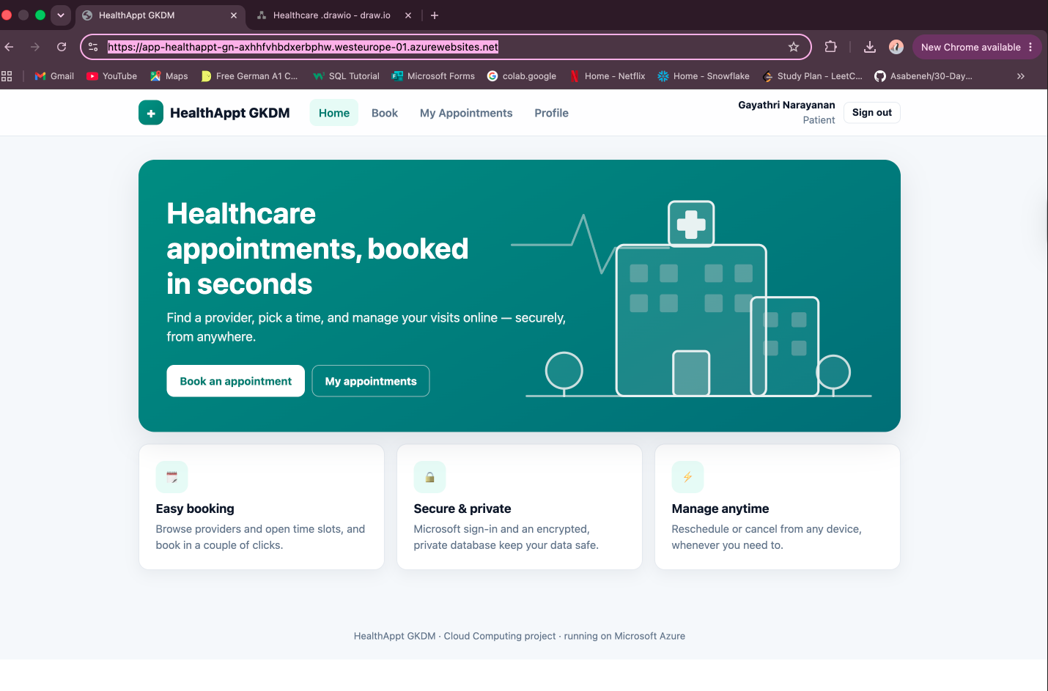
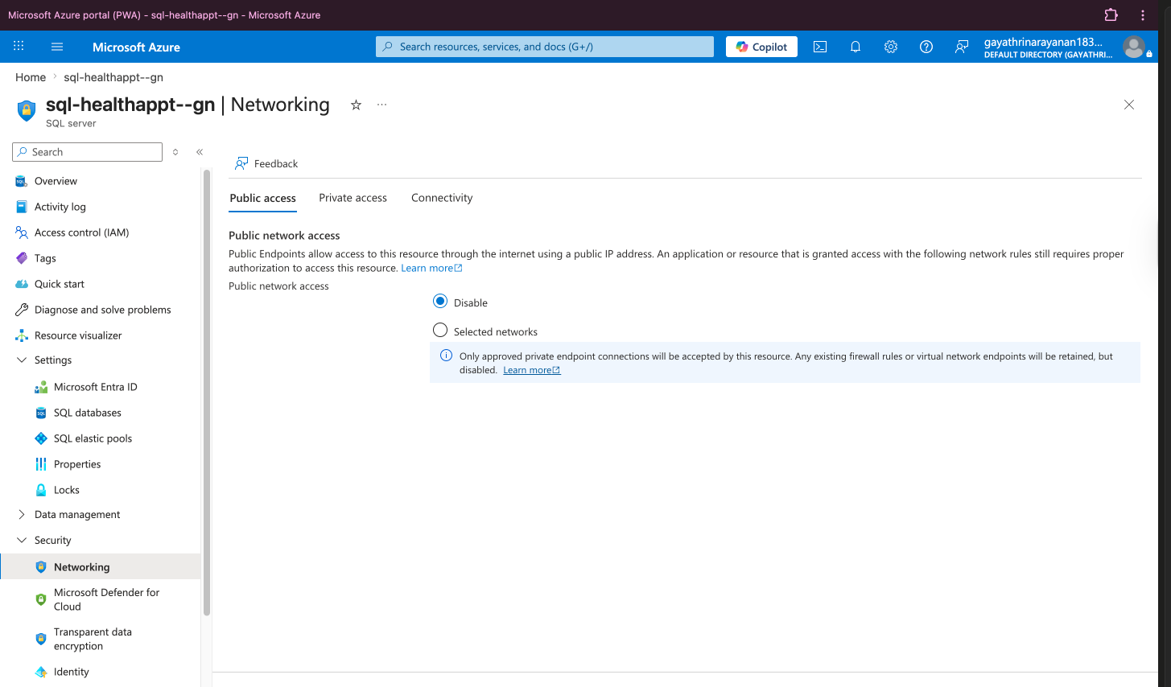
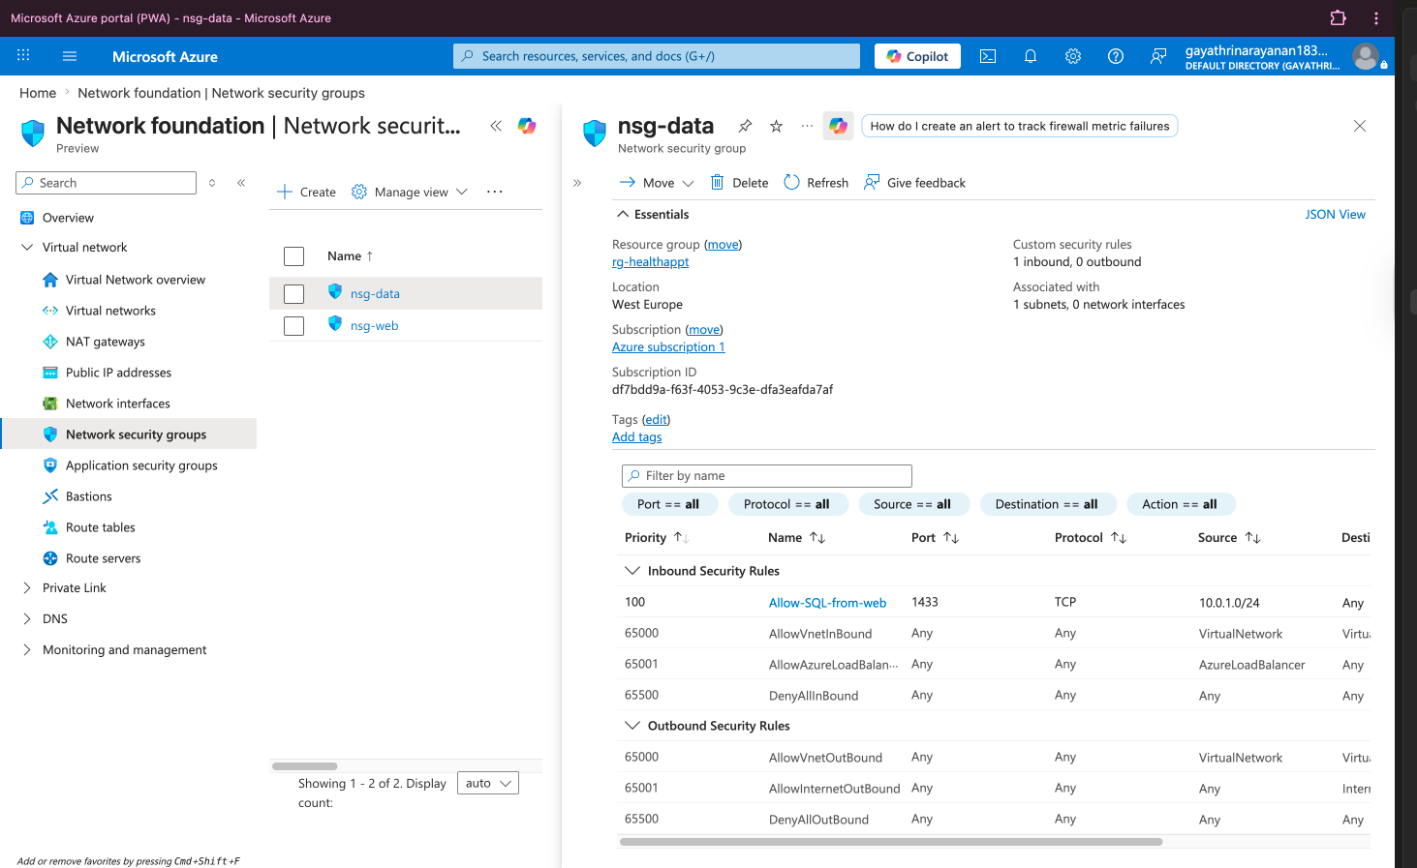
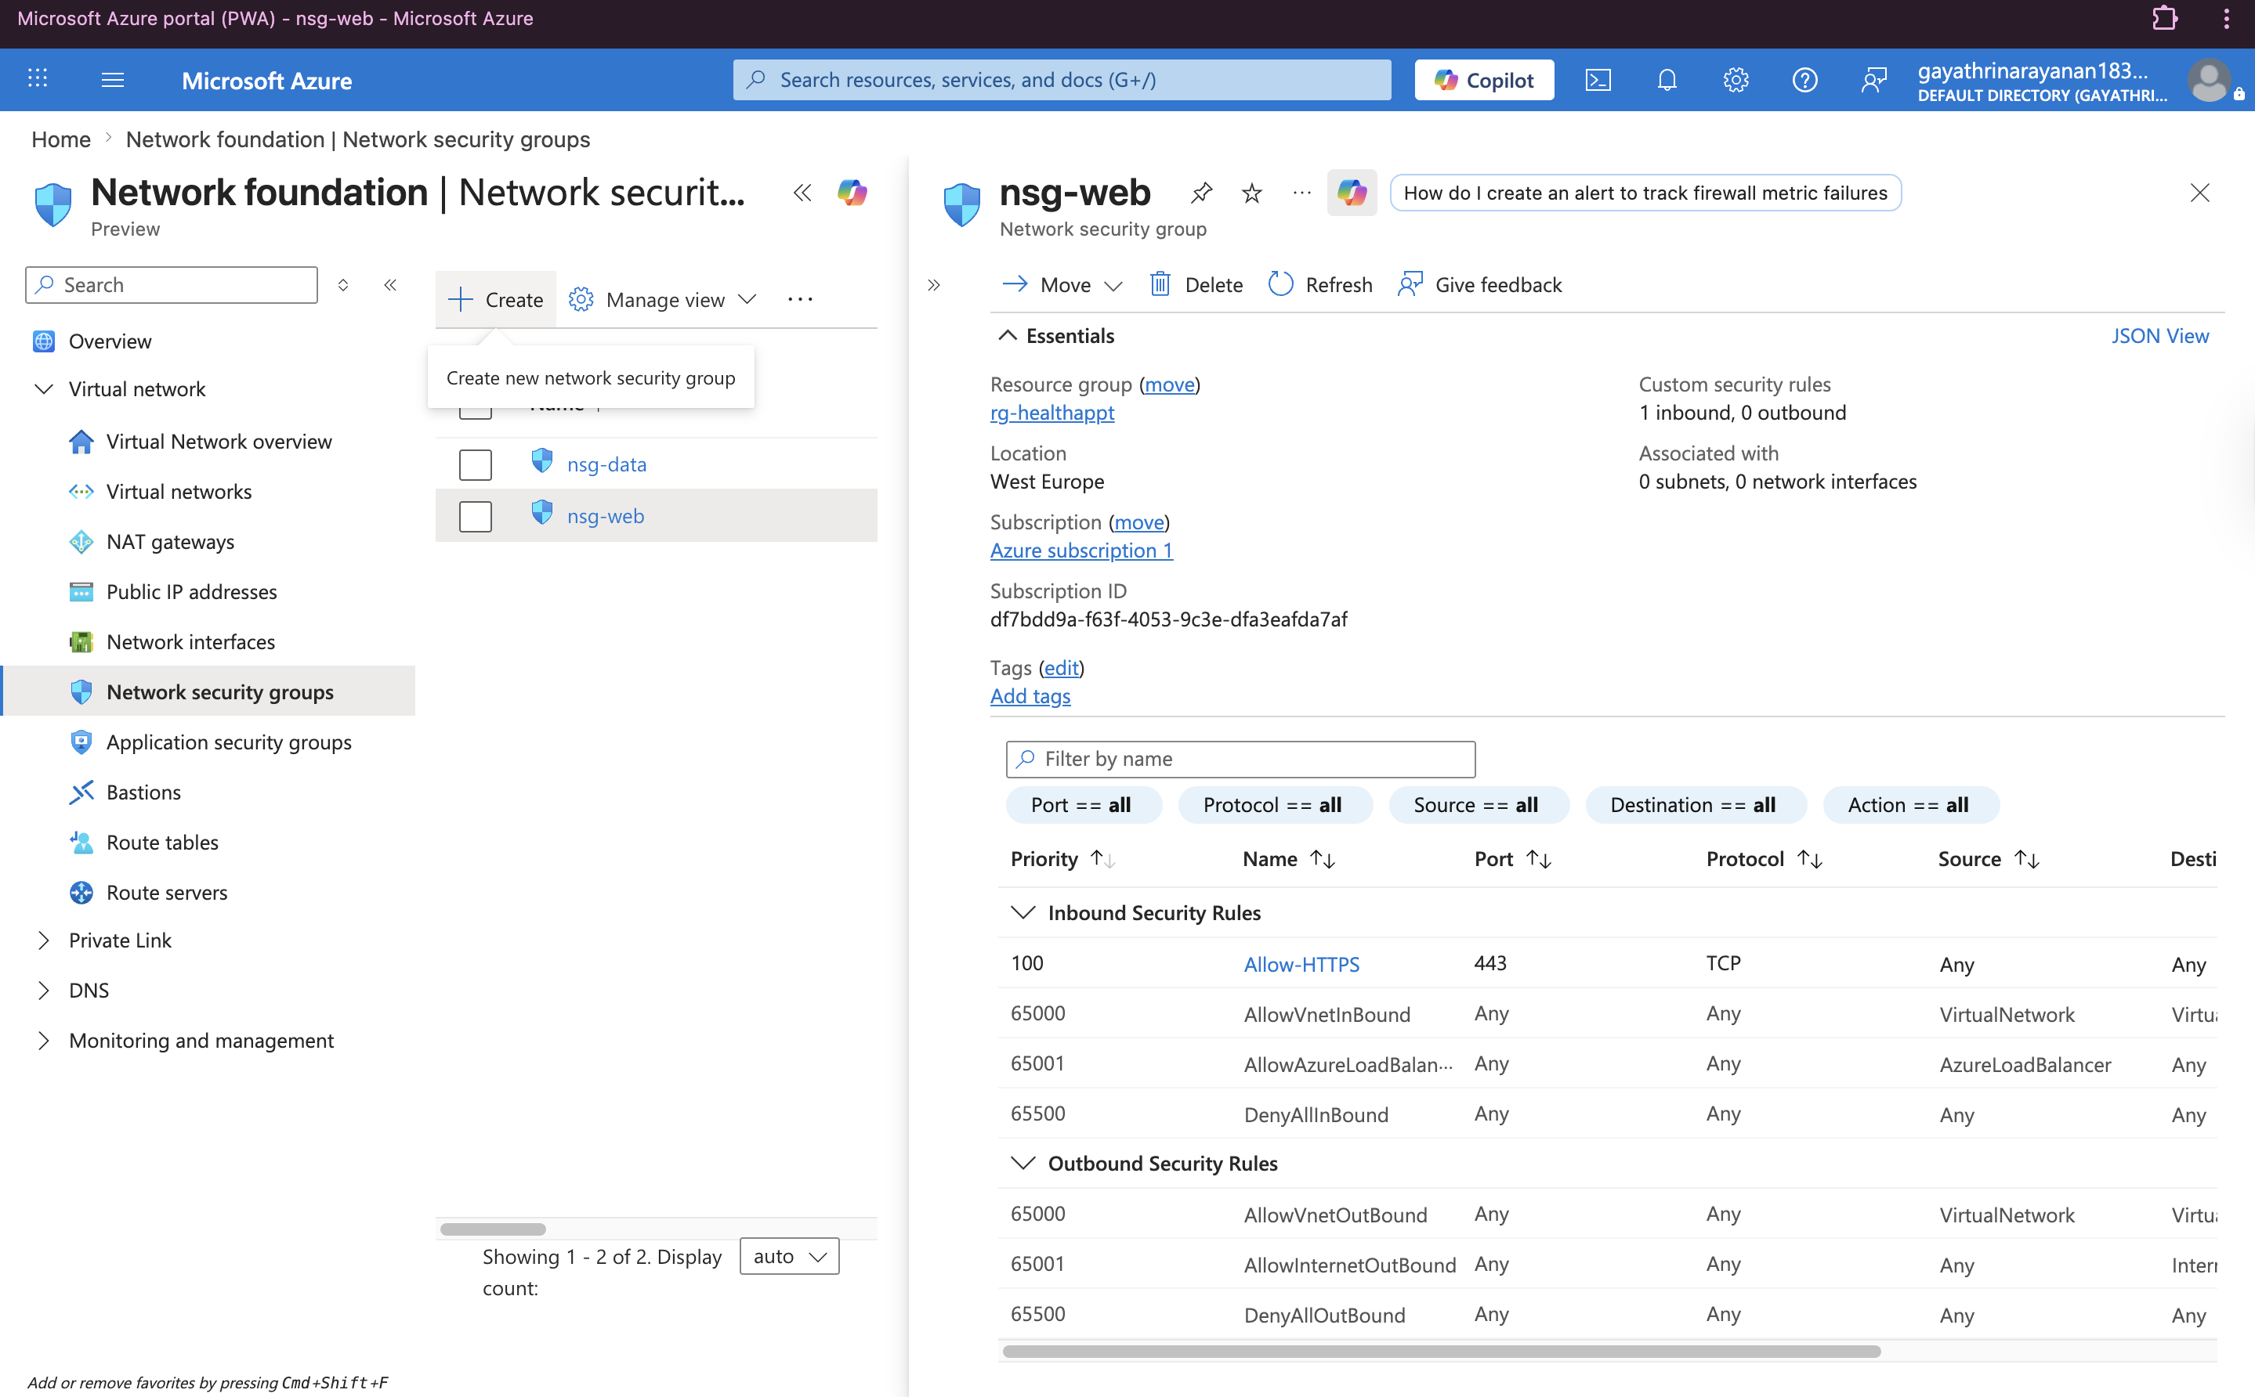
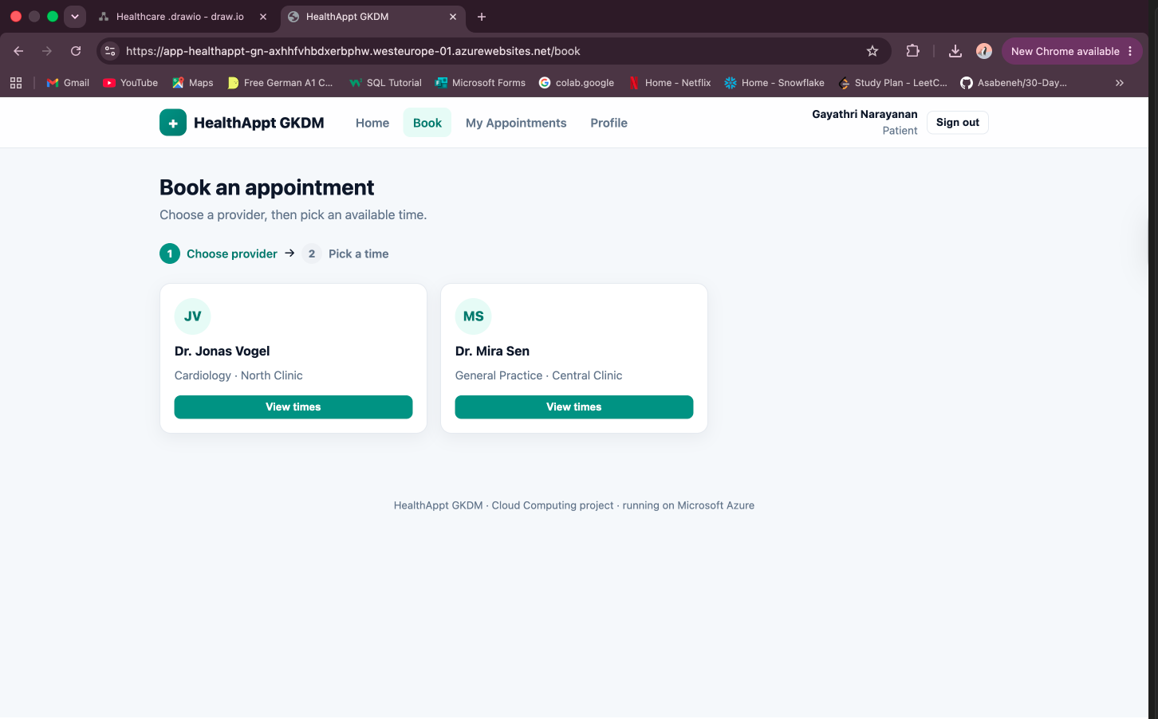
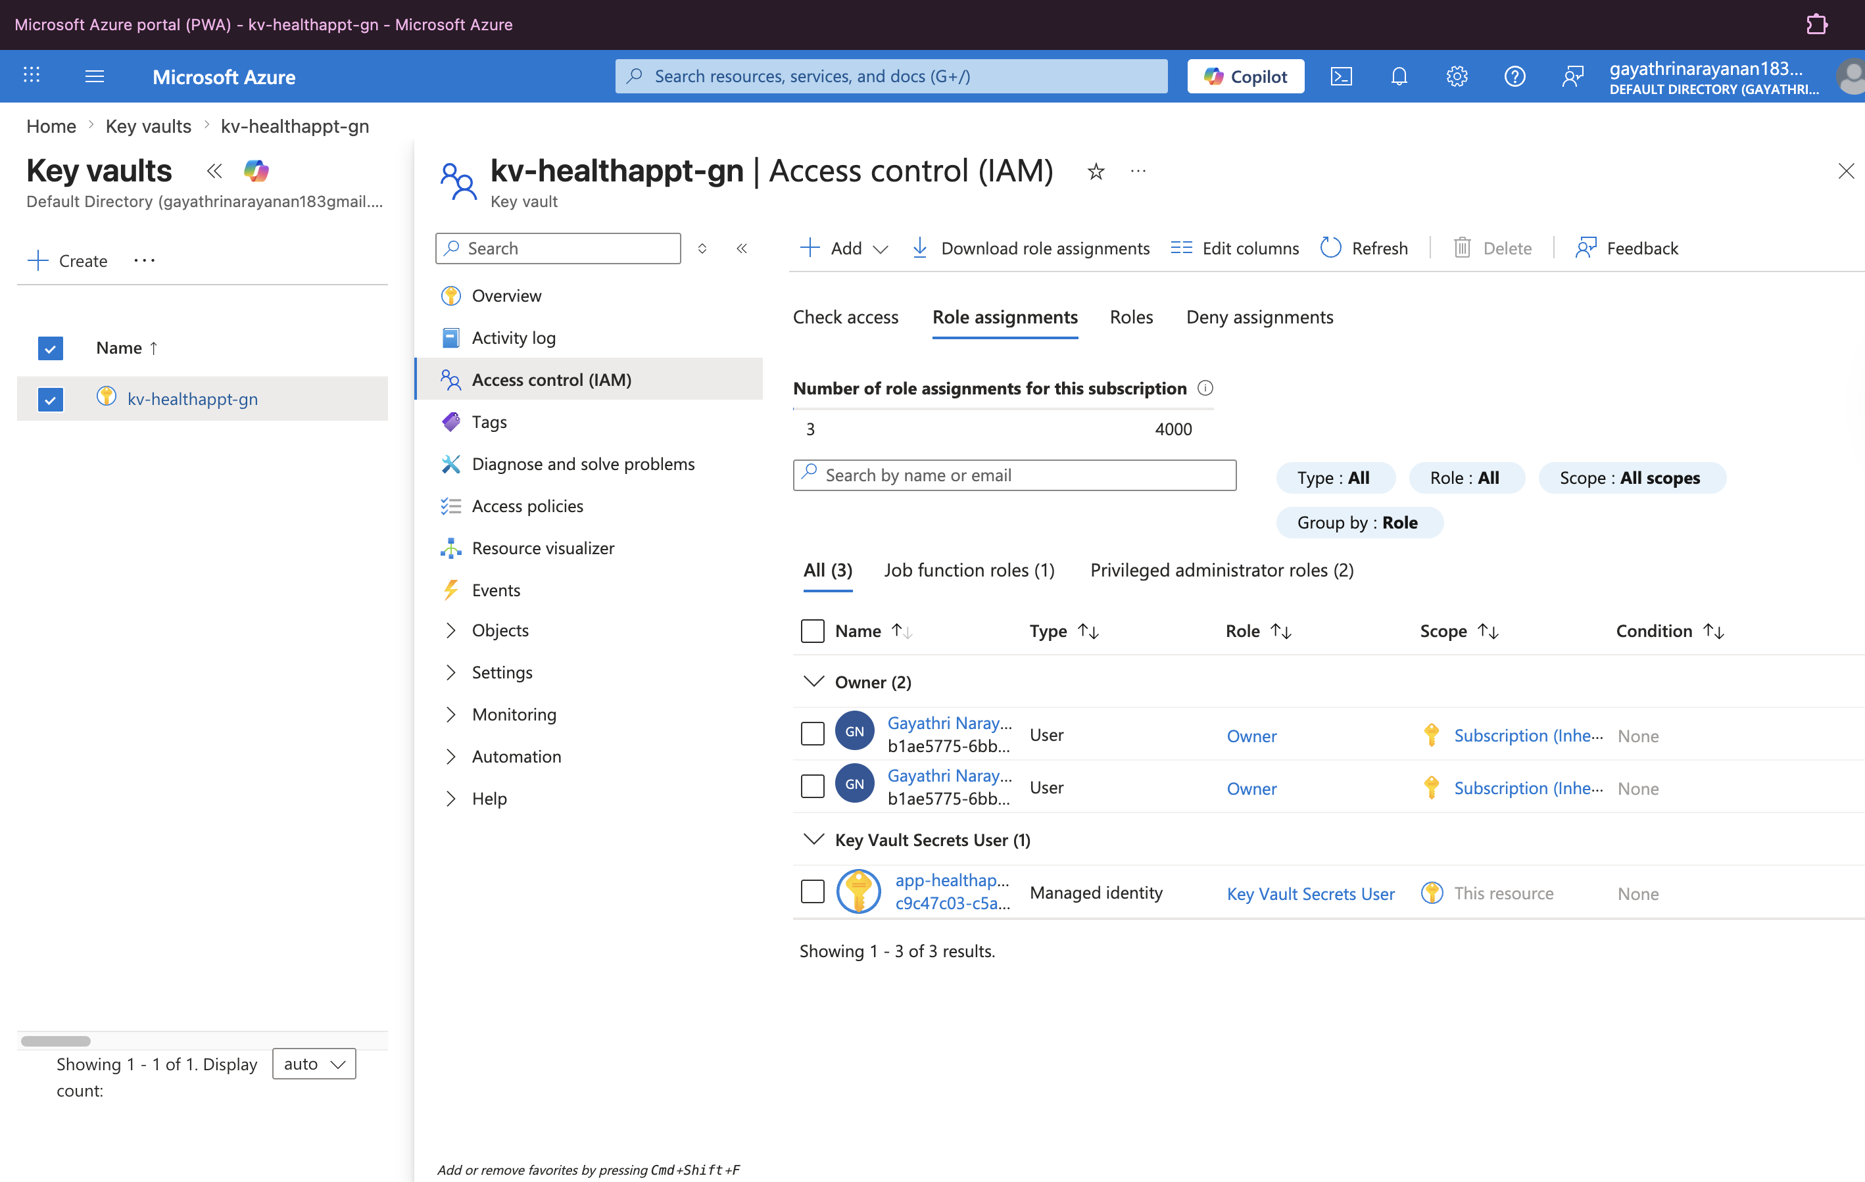
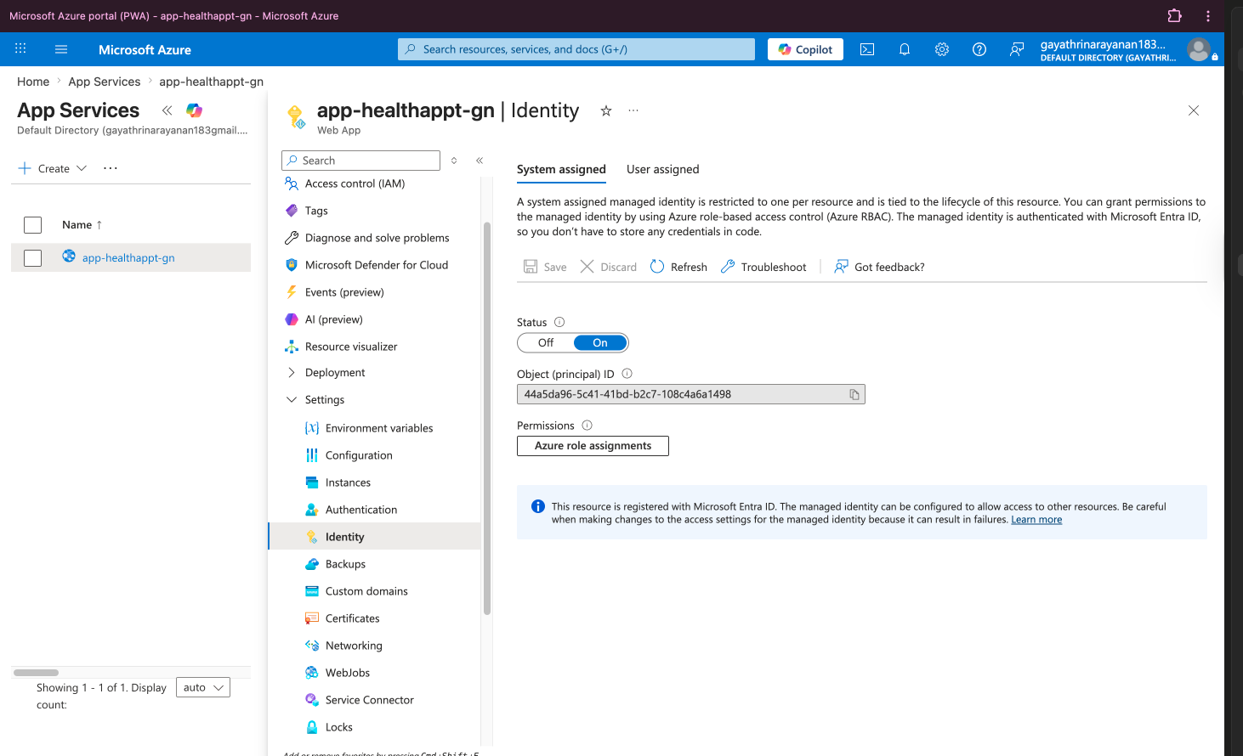
09
Evidence — Portal Screenshots
HTTPS padlock — live site
Azure SQL: public access No + TDE
NSG rules: nsg-web & nsg-data
App signed in — data from Azure SQL
Key Vault + role assignment
Managed identity on the App Service
09 / 18
Notes:
Our evidence: the live site with the HTTPS padlock; the database with public access Disabled; our NSG firewall rules; the app signed in showing real data from Azure SQL; the Key Vault role assignment; and the App Service's managed identity switched on.

Slide 10
10
Big Issues Faced & Solutions
!
Database cold-start timeouts
!
Login blocked on the live site
The serverless DB auto-pauses; the first request timed out. Fixed by raising the connection timeout and retrying — and we pre-warm the app before demos.
The security headers (CSP) blocked Microsoft login. Fixed by allowing the Entra endpoints (login.microsoftonline.com) in the policy.
!
Production build failed
!
Reaching a private database
A top-level await broke the production build. Fixed by restructuring the MSAL startup so it initialises before render.
With the DB locked to a private endpoint, our changing home IP made local access fiddly. We used a temporary dev rule while building; the deployed app uses the private endpoint.
10 / 18
Notes:
Real problems we solved: the serverless database pausing caused a slow first request — we raised the timeout and pre-warm before demos; the browser's security policy blocked Microsoft login — fixed by allowing the Entra endpoints; a build error — fixed by changing how the app starts up; and reaching the private database while building was fiddly — we used a temporary dev rule.

Slide 11
11
Where We Used AI
✓ Used AI for
✗ Did NOT use AI for
Front-end / UI code scaffolding and styling
Boilerplate code, refactors and troubleshooting guidance
Writing documentation and assembling this deck
The architecture diagram — hand-drawn, as the course requires
The Azure configuration: every networking, security and deployment step was performed by us on the live portal
11 / 18
Notes:
We're transparent about AI. We used it for front-end scaffolding, boilerplate, troubleshooting, and assembling this deck. We did NOT use it for the architecture diagram — that's hand-drawn, as the course requires — or for the Azure configuration, which we performed ourselves in the portal.

Slide 12
12
Final Project Budget Projection
App Service (Basic B1, Linux)
$13.14
Private endpoint (Private Link)
~$7.30
Azure SQL — storage
~$1.25
Azure SQL — compute (serverless)
$0–20
Private DNS zone
~$0.50
Key Vault · App Insights · VNet · Entra ID
~$0 (free)
Figures from the Azure Pricing Calculator. The serverless database costs ~$0 when idle; show actual spend in Cost Management → Cost analysis.
12 / 18
Notes:
Running cost is about $30 a month, estimated with the Azure Pricing Calculator. The main costs are the App Service and the private endpoint; the serverless database is nearly free when idle. Actual spend is visible in Cost Management, Cost analysis.

Slide 13
13
Individual Contribution — 1 of 4
DR
Dimple Vincia Selet Rajendrakumar Roopa
Matriculation: 37113279
Front end & compute: built the React (Vite) single-page app and the Express REST API.
Deployed the app to Azure App Service and configured the managed identity.
Owned the deployment pipeline and the live build.
Focus areas
React + Vite
Express API
App Service
Deployment
13 / 18
Notes:
Dimple — front end & compute: 'I built the React app and the Express API, deployed it to Azure App Service, and set up the managed identity so the app reaches the database with no password.'

Slide 14
14
Individual Contribution — 2 of 4
GN
Gayathri Narayanan
Matriculation: 32638539
Database: designed the Azure SQL schema and seeded the sample data.
Built the data-access layer and the SQL queries.
Configured the private endpoint for the database.
Focus areas
Azure SQL
Schema design
Private endpoint
Data layer
14 / 18
Notes:
Gayathri — database: 'I designed the Azure SQL schema — patients, providers, appointments and time slots — and configured the private endpoint so the database is only reachable from inside our network.'

Slide 15
15
Individual Contribution — 3 of 4
KU
Kamalika Bharathi Kannan Umamaheshwari
Matriculation: 52931479
Networking: designed the VNet and the snet-web / snet-data subnets.
Wrote the NSG firewall rules (443 inbound, 1433 internal only).
Set up the App Service VNet integration.
Focus areas
VNet + subnets
NSG rules
VNet integration
15 / 18
Notes:
Kamalika — networking: 'I built the virtual network and the two subnets, and wrote the NSG firewall rules — 443 in for the web app and 1433 only from the web subnet. I also connected the App Service into the network.'

Slide 16
16
Individual Contribution — 4 of 4
MS
Maharsh Ashish Shah
Matriculation: 88301364
Security & identity: Microsoft Entra ID app registrations and app roles.
Azure Key Vault and Application Insights monitoring.
The cost estimate and project documentation.
Focus areas
Entra ID
Key Vault
App Insights
Budget
16 / 18
Notes:
Maharsh — security & identity: 'I set up Microsoft Entra ID login and the Patient/Provider/Admin roles, added Key Vault and Application Insights, and worked out the running cost.'

Slide 17
17
Final Project Summary
What went well
Tradeoffs & next time
A complete, secure, multi-tier Azure deployment that is genuinely live.
Passwordless managed identity and a private database — security built in, not bolted on.
Microsoft Entra ID sign-in with role-based access done properly.
Single App Service instance (no autoscale / Front Door) to stay simple and cheap.
Serverless database (small cold-start) chosen over an always-on tier.
Manual deployment this time — next time, Terraform (IaC) and a CI/CD pipeline, plus SMS / email reminders.
17 / 18
Notes:
In summary: a complete, secure, live multi-tier Azure deployment — private database, passwordless identity, Microsoft login, encrypted throughout. Tradeoffs: a single instance and a serverless database to stay simple and cheap. Next time: infrastructure-as-code with Terraform, a CI/CD pipeline, and autoscaling behind Front Door.

Slide 18
Questions
Thank you — we're happy to take questions.
https://app-healthappt-gn-axhhfvhbdxerbphw.westeurope-01.azurewebsites.net
Dimple Vincia Selet Rajendrakumar Roopa · Gayathri Narayanan · Kamalika Bharathi Kannan Umamaheshwari · Maharsh Ashish Shah
Notes:
Thank you — we're happy to take questions. Keep the architecture answers ready: why two subnets, where the data is stored, why Azure over AWS, how it's passwordless, and the cost.

